Slide 1
PTL-H Devkit Test Flow
WW32’24
CCG CPE CPS MTE test team Rev 1

Slide 2
CCG Intel Factory Test Team
Title | Name
Test Program Manager | Krishnan, Jagathasen (Jack)
DFT Engineer | Krishnan, Jagathasen (Jack)
FT Test Developer (Board Level) | Krishnan, Jagathasen (Jack) M. Parkash (Onsite)
FA | Hamzah, Muhammad Zuhdi (Zuhdi)
SW Dev. ITs | Mohamad Ayu (Ayu)

Slide 3

Devkit Board & System MFG Test Flow
Board Level FT
Fail
FA/Debug
SMT
5DX
Flash Inline programming/RFID
BFT
(Functional Test)
~ 5 Min
~20 Min
System Level FT
FA/Debug
Fail
Fail
Pretest or FW Ifwi programming
SFT (system level FT)
TAT (thermal analysis)
OQA
Pack
~ 5 Min
~20 Min
~ 25 Min
~15 Min
Devkit Main board and AIC do not have Flying probe test due to low DFT coverage –Factory uses improved FT test to compensate.
Incoming silicon components must be tested using gold boards or PTL RVP boards to ensure they can successfully boot to the Windows operating system. This testing is carried out by the test team before the silicon components are soldered onto the board using SMT technology. The purpose is to confirm that the silicon components are functional before they are integrated into the final product.

Slide 4
Factory Test Plan Milestone
PO | PO + 1 Weeks | PO + 3 Weeks | PO + 5 weeks
5DX | 5DX | 5DX | 5DX
NO BFT | Prelim FT (Iron Test) | FT (Iron Test) | Final FT Iron Test
Open short Check 5DX coverage @100% FW Programming *No Functional Test | 2nd build 5DX coverage @100% *Functional test is on best effort. - Depends on BIOS, Silicon stability and SW/HW availability | Follow on builds 5DX coverage @100% Expecting board FT coverage is >80%. | Follow on builds BFT coverage >96% Expecting System FT coverage is > 100%
Board successfully PO & successfully boot into OS
Prelim FT ~ 1 week after board PO/Boot to OS/Features which can be supported.
Interim FT ~ 3 weeks after board PO/Boot to OS/Features which can be supported.
Final FT ~ 5 weeks after board PO/Boot to OS/Features which can be supported.
*Note/Assumption: Board & CPU availability.

Slide 5

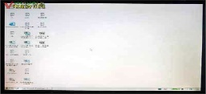
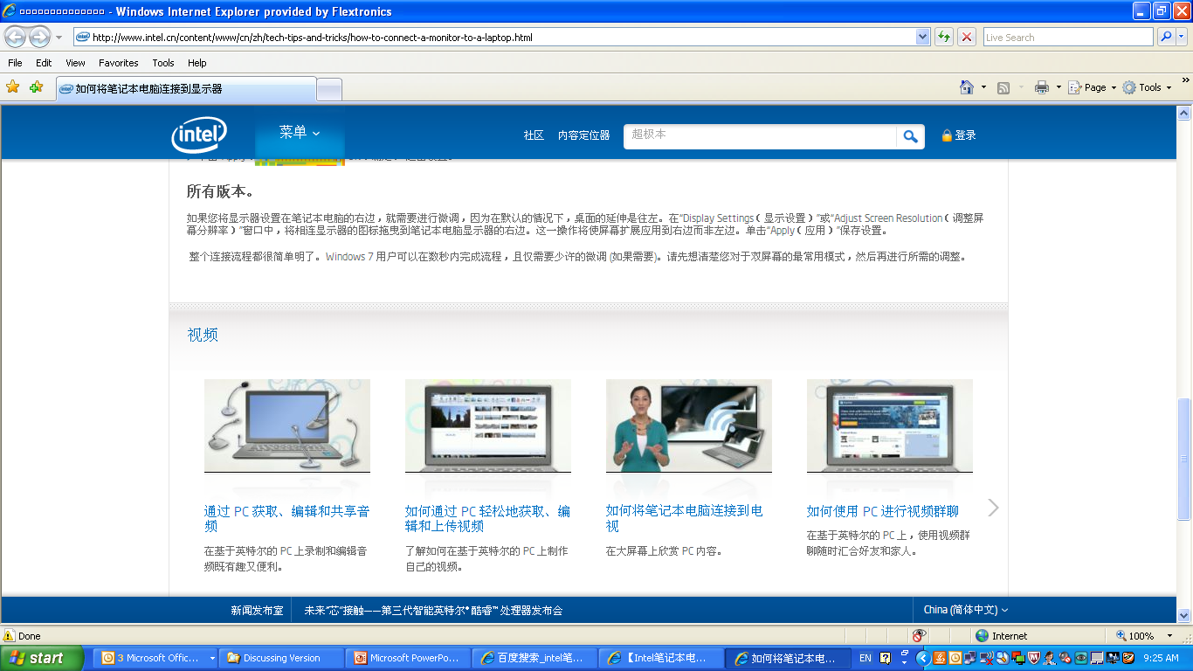

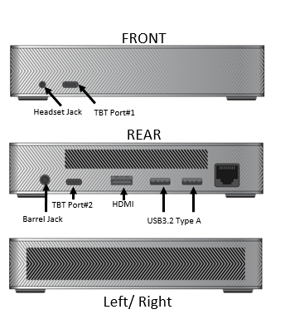
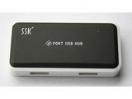

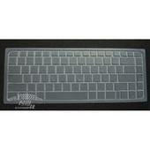

Board & System Functional Test (BFT & SFT )
Test Coverage:
CPU + PCH Module test
Memory function check
Display ( HDMI & DP)
Audio function check ( Codec + Audio Jack+Mic)
USB2.0/3.0 basic function check
Type C - 3.2/3.0/2.0 & HDMI/Dp
Graphics check
PCIE Slot
M.2 SSD 1 SLOT
M.2 Key E slot for WiFi/BT
LAN Module Checking - new
Mac Address –new
AC mode check
Thunderbolt Check
Keyboard & Mouse
CPU FAN check
EC/SPI firmware
LED check
TPM Check
Switches/Buttons Check
Test Software:
Windows 11
Chrome OS- new - TBD
Iron Test execution.
AC adapter
DP & HDMI
Panel
USB HUB
SATA SSD
AUDIO codec
SATA
SD card
Key Board
Network
NGFF SLOT
NGFF SLOT
SATA SSD
BIOS , FW FLASH
Ex: Test cases for LNL-GCS

Slide 6
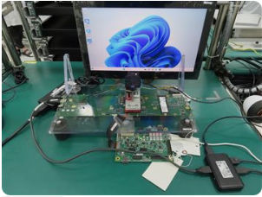
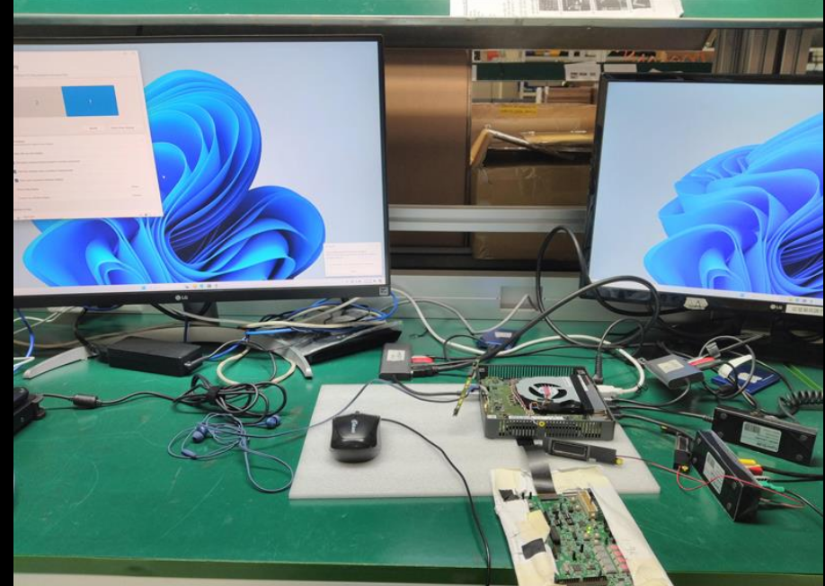
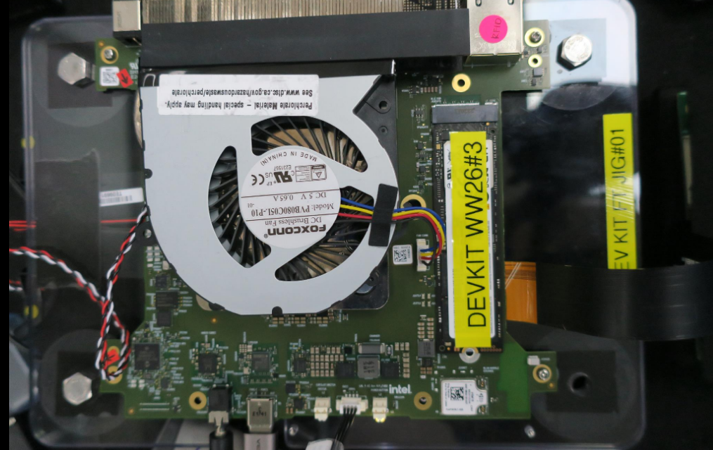
Example Board and System level FT tester Overview
Hardware Timeline
We have finalized the timeline for the 1st , one set of PTL DEVKIT hardware will consign to factory and also will need factory to purchase some common test hardware for FT , ensuring that the process is well-organized and efficient. Here is a brief overview of the key milestone.
Phase 1: consign hardware to a factory for production (ww42-43)
Phase 2: Identify the specific firmware version or release that needs to be programmed offline (ww42-43)
Phase 3: CPU availability and pretesting by weeks ( TBD)
Phase 4: Assembly and Setup and testing (TBD]
Detail inventory list of the hardware and equipment preparation on progress.
Factory offline programming
- Need to specify the required programming interface or new socket for offline programming.
- 1st Open chasis build will be no FT only open/short and ship out subsequence build will resume to FT.
Programming requirement PTL- Devkit still TBD.

Slide 7
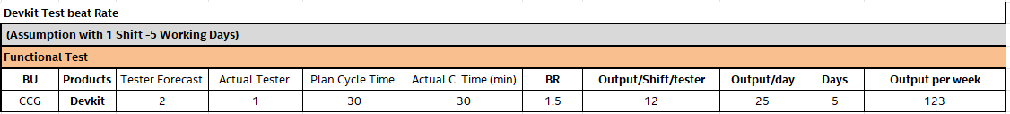
Test Bit Rate
Below Test Bit Rate with assumptions with Sanmina working model 1 Shift (5 days/week)
Below Test Bit Rate with assumptions with Sanmina working model 2 Shift (5 days/week)
The number of testers allocated for testing may vary depending on the volume of products to be tested and the timeline for shipping those products. If there's a high volume of products or tight shipping deadlines,we may allocate more testers to ensure efficient testing and timely delivery.

Slide 8
BACK-UP

